Slide 1
Investigating Rocks
Granite
Conglomerate
Gneiss
A rock is a mixture of two or more minerals. Rocks can be grouped into three families, depending on how they formed.

Slide 2
Igneous Rock
forms from the cooling of molten (melted) rock material
CRYSTALS are formed - the size depends on whether the rock cools quickly or slowly
igneous rocks are divided into two groups, depending on where the rocks cooled

Slide 3
INTRUSIVE ROCK
If the magma cools and hardens below the earth's surface, the rocks formed are intrusive( inside the earth) rocks.
These rocks cool slowly and there is time for large crystals to form.
An example of a intrusive rock is Granite.

Slide 4
EXTRUSIVE ROCK
If the magma reaches the earth's surface (lava) it cools and hardens quickly.
There is no time for crystals to form and the rock looks homogeneous.
For example: Basalt.

Slide 5
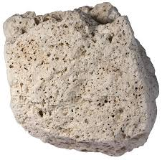
EXTRUSIVE ROCK CON’T
Sometimes the lava hardens so quickly that it forms volcanic glass which is called Obsidian.
Another type of extrusive rock forms from frothy (foamy) lava and is called Pumice.

Slide 6
Intrusive VS Extrusive RECAP
When magma cools and hardens below the Earth’s surface the rock is called intrusive rock.
Lava is what the molten material is called that breaks through the Earth’s surface in the form of a volcanic eruption. When lava cools on the Earth’s surface, that rock is called extrusive rock.

Slide 8
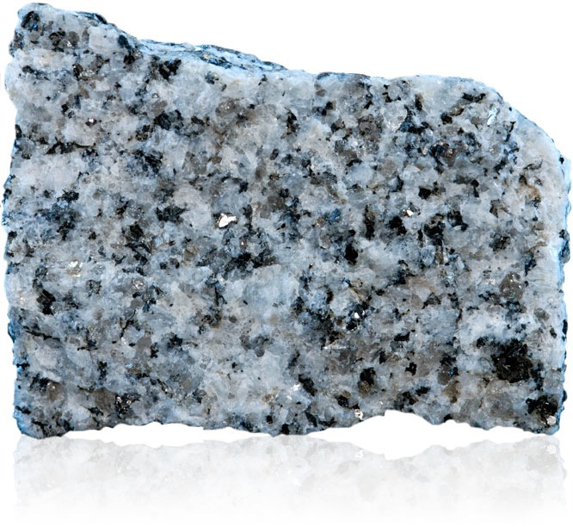
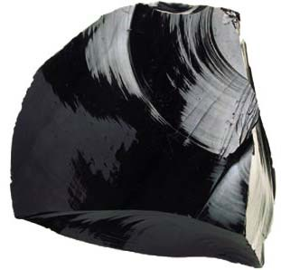
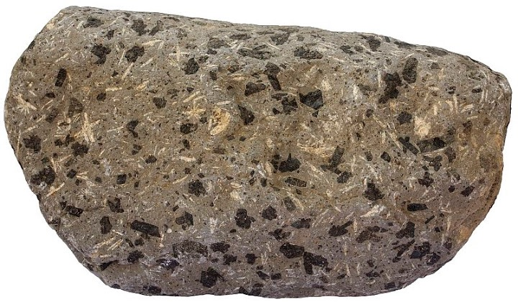
Granite forms very deep and very slowly in the Earth’s crust. What type of IGNEOUS rock is it?
The time it takes for lava to cool determines the size of crystals in the rock, or whether crystals form at all.
Basalt & obsidian

Slide 9
Sedimentary Rock
Sedimentary rocks form from the compaction and cementation of sediments into visible layers called beds.
often made in oceans and lakes where the larger, heavier sediments settle first.

Slide 10
Sandstone
Limestone
Shale

Slide 11
Let’s check out PAGE 331

Slide 12
Metamorphic (changed form) Rock
rocks made when heat, pressure, or hot fluids change one type of rock into another type of rock.
made from igneous, sedimentary or other metamorphic rocks
the process is long and slow

Slide 13
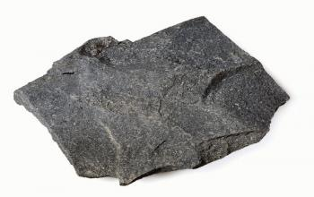
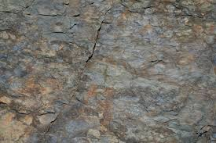
Parent Rocks
Metamorphic rocks form below the surface of Earth where heat and pressure are very high.
the rock that has been changed into a metamorphic rock is called the parent rock.
Another example would
be shale turning into slate.

Slide 14
Let’s check out PAGE 332-333

Slide 15
CHECK FOR UNDERSTANDING
Complete questions 1-10 & 12
Page 339

Slide 16
The Rock Cycle

Slide 17
Rock Cycle
Rocks are always changing. One type of rock may turn into another.
An example is sedimentary rocks may get pushed underground and get melted into igneous rocks, or igneous rock may get put under high pressure and change to metamorphic rock.
This process of rocks continuously changing is called "The Rock Cycle". Another way of saying this is that rocks are continuously recycled into different forms.

Slide 18
We can see the processes that cause this recycling of the rocks in the diagram to the right.
Weathering and erosion can turn igneous and metamorphic rocks into sedimentary rocks.
Heat and pressure can change sedimentary and igneous rocks into metamorphic rocks.
Melting and cooling changes metamorphic and sedimentary rocks into igneous rocks.

