Slide 1
Minerals
a pure, naturally occurring, inorganic, solid substance.
INORGANIC: not consisting of or
deriving from living matter.

Slide 3
Pyrite
Gold
Diamond

Slide 4
Minerals Around Us
Lots of metals like silver, aluminum and tin come from minerals.
Ground up halite (table salt) on your food.
Calcium keeps your bones and teeth strong.
Copper and iron help keep your blood healthy.

Slide 5
Sand Detective
Most grains in sand are quartz, one of the most common minerals on Earth. Quartz can be white, pink, brown, or other colours.
Thin black flaky grains in the sand are probably mica.
Some white or grey particles may be feldspar.

Slide 6
You can identify a mineral by examining it’s properties:
colour
lustre
streak
hardness
cleavage
fracture

Slide 7
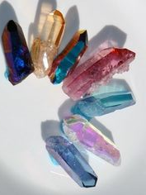
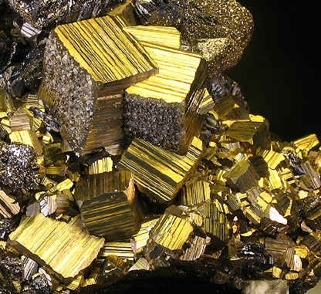
Colour
Colour alone is not a reliable test to identify minerals!!!
One type of mineral can have many types of colours (see right!)
The valuable mineral gold has a golden colour, but so does the much less valuable mineral pyrite
Which is which?!
Check out all the different coloured quartz!

Slide 8
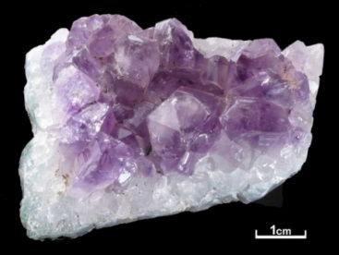
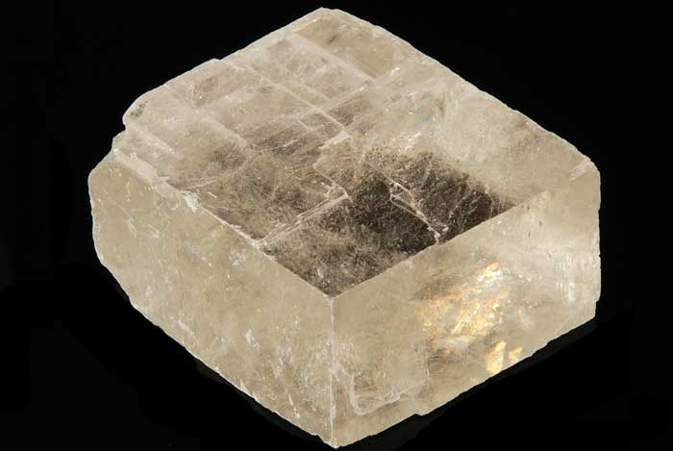
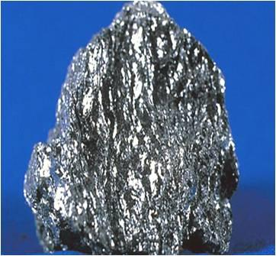
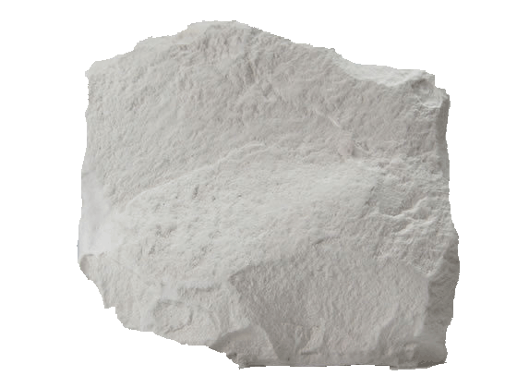
Lustre
Identifying a mineral based on how shiny it is!
The shininess, or lusture of a mineral depends on how light is reflected from its surface.
If a mineral reflects light like a piece of glass, it has a GLASSY lustre.
If the mineral does not reflect light well, it has a DULL lustre.
If a mineral shines like a polished metal surface, it has a METALLIC lustre.

Slide 9
Streak
The mineral hematite can be dark red, grey or silvery in colour. It’s streak, however, is always brick red.
A reliable way to identify a mineral!
The mark it makes is called a STREAK (a powered form of the mineral)
Gold makes a yellow streak
Pyrite makes a greenish-black or brown-black streak
Rub the mineral across a piece of unglazed porcelain tile

Slide 10
Hardness
Hardness is a measure of how difficult it is to scratch a mineral
We use the Mohs Hardness Scale to help us identify minerals
The scale is ranked 1-10
The higher the number on the Mohs Scale, the harder the mineral.

Slide 11
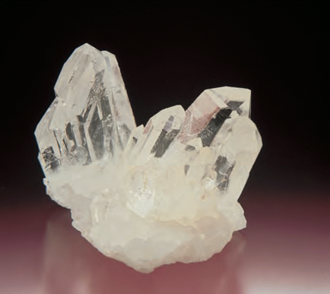
Cleavage or Fracture
In order to check for cleavage or fracture a mineral must be broke
It is best if you can look at a freshly broken surface of a mineral
A mineral has cleavage if it splits along smooth, flat surfaces called planes
A mineral has fracture if it breaks with rough or jagged edges
Mica is a mineral with a single cleavage that allows it to be pulled apart into sheets.
Mica
Note, there is no particular pattern in the jagged edges.
Quarz

